Slide 1

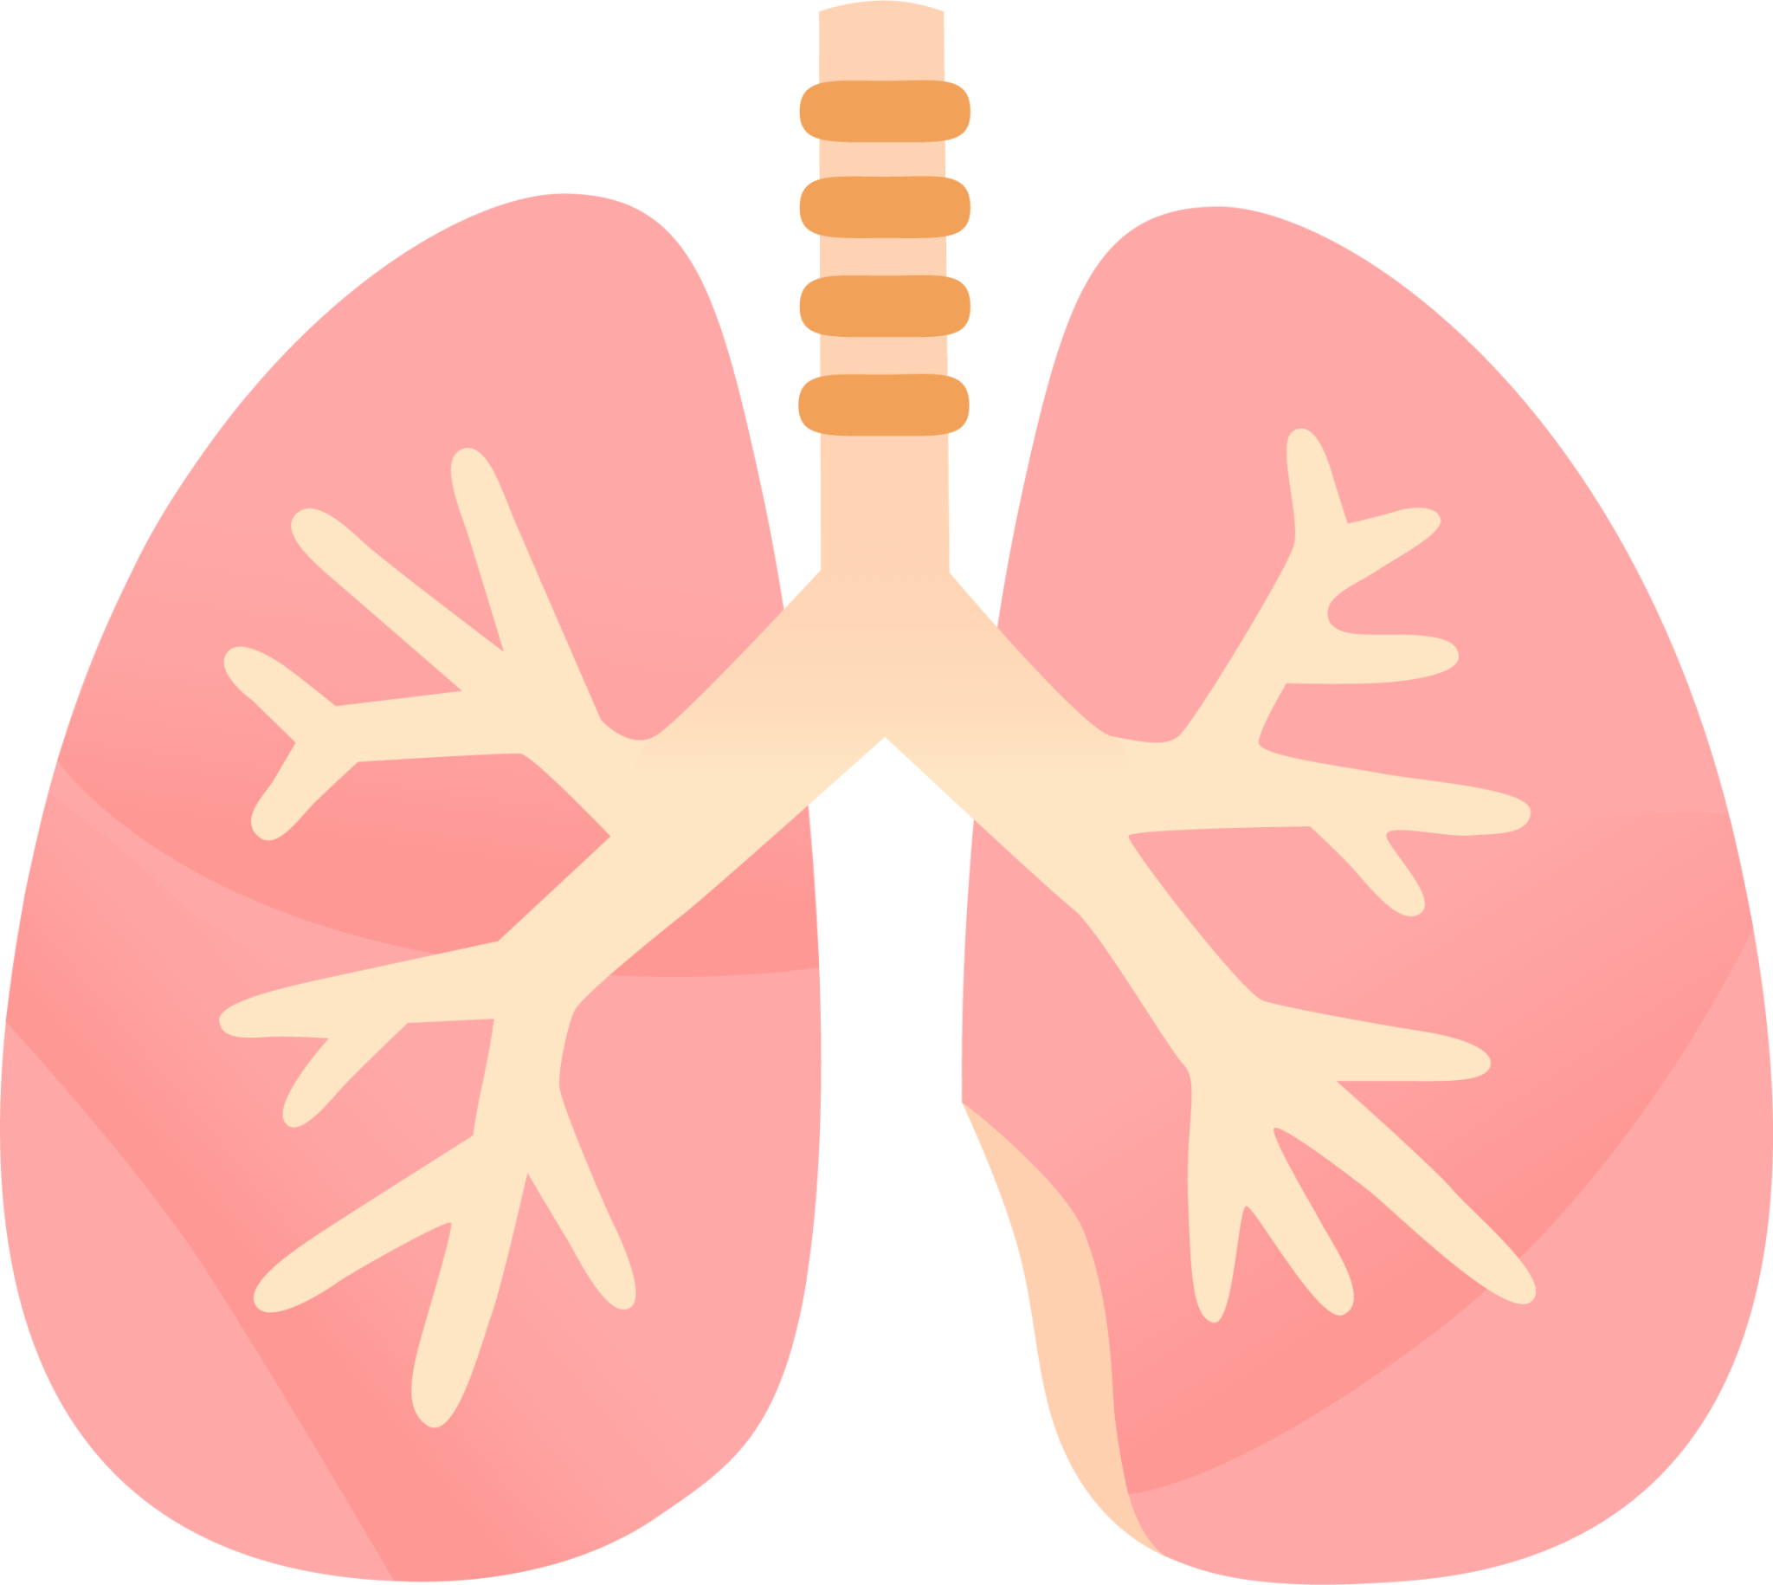
LUNG SOUND RECORDER
Team: Quad-Core Squad
By: Karthik, Aryanil, Anurag, and Adithya
Professor: Abhishek Srivastava
TA: Santhoshini
Week-7

Slide 2
CNN model
We generated a fully functional CNN model for classifying the sound sample with around 90 to 95% accuracy
We created 2 files : CNN_train.py to train the model on the dataset provided at https://data.mendeley.com/datasets/jwyy9np4gv/3
and CNN_predict.py to predict the disease.

Slide 3
CNN model
We are classifying the .wav file into 4 categories: normal, wheezing, crackle, and both.
We also generated a classification report and a confusion matrix after training the model

Slide 4
CNN model
Initially when we trained the model and generated the confusion matrix, we observed that it was a 3 by 3 grid, i.e, there was no class corresponding to the class containing both.
After analyzing the dataset, we found that this was occurring because there were only 6 .wav files corresponding to the both class out of the 336 files present and none of them were getting included in the training dataset.
To fix this, we duplicated the existing 6 files so that the number of such files increases and after this change, the confusion matrix generated was a 4 by 4 grid.

Slide 5
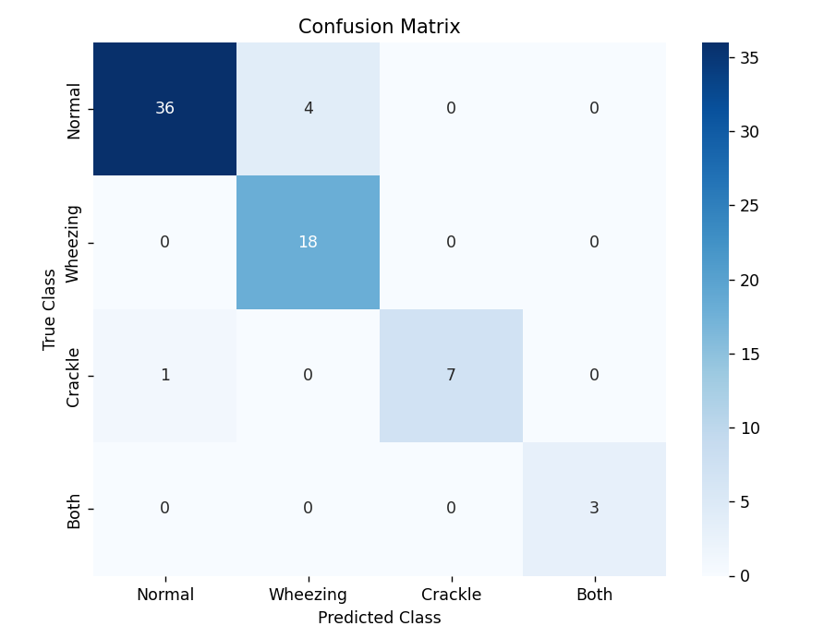
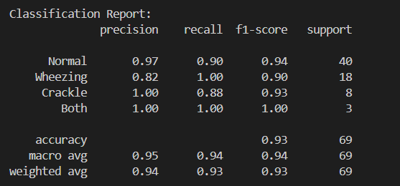
Classification report Confusion matrix

Slide 6
SVM Model
The SVM model works by collecting MFCC data
MFCC are used to represent characteristic features of sound
Mel-frequency cepstral coefficients (MFCC) are a set of coefficients that capture the shape of a sound signal. DFT is used to determine the coefficients of MFCC.

Slide 7
Process
We are also classifying the .wav file into 4 categories: normal, wheezing, crackle, and both.
Accuracy was improved upon doing better preprocessing.
The test size was 20 percent and the training size was 80 percent/

Slide 8
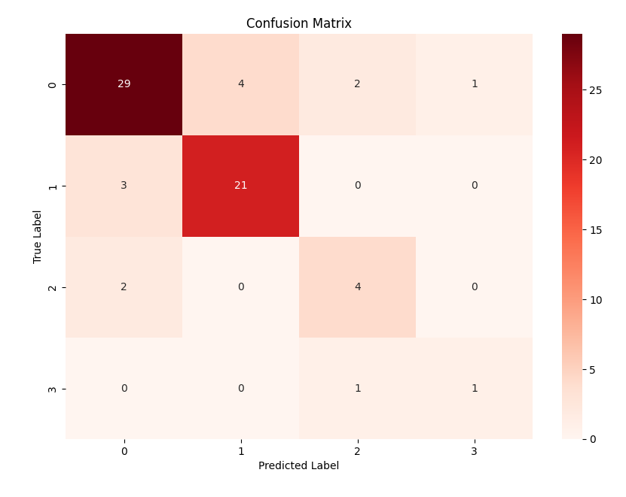
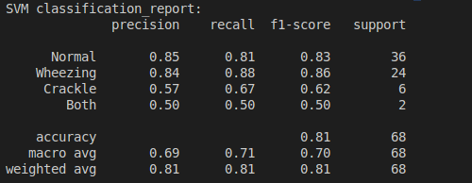
Classification Report

Slide 9
Making an application

Slide 10
This week
The frontend of the application was created.
I used vanilla html, css and tried working with tailwind js, flowbite etc.
The website was created with the intended backend of Flask and was hosted locally.
The demo of the website can be found at the official project repo: https://github.com/AryanilPanja/lung_sound_recorder

Slide 11
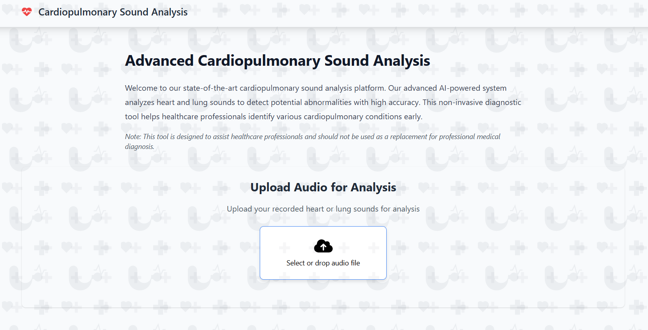

Slide 12
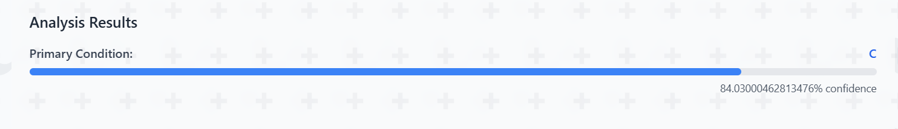
Output
The website outputs the predicted class along with the confidence score of the prediction

Slide 13
Next Steps
Final Integration from the recording to the website output.
Improvement of quality of lung sound recording from the stethoscope.
Streamlining, pipelining of the whole process for a seamless experience

